Slide 1


Al-Karkh University for Science
Collage of Science
Medical Physics Department
General Biology II
" Practical"
Prepared by
Dr. Hiba Shakir Ahmed Dr. Rawa Abdul Redha Aziz
Ph.D Microbiology/Immunity Ph.D Antibiotic Molecular Biology

Slide 2
culture media
LAB ((2))

Slide 3
1. Definition culture media
Culture media is a special medium used in microbiological laboratories to grow different kinds of microorganisms. A growth or a culture medium is composed of different nutrients that are essential for microbial growth. The basic nutritional requirement including:
1. Energy source 2. Carbon source (contain carbon)
3. Nitrogen source : A. organic compound (amino acid) B. inorganic compound NO₂,NO₃,and NH₄). 4- Sulfur and phosphor (important for production of nucleic acid and proteins)
5. Mineral : A. macro elements: require in small amount e.g. Mg, Fe, Ca, and K) B. micro elements : requires in large amount e.g. Zn, Cu, Mn, Co, Mo, and Ni.

Slide 4
2. Classification of culture media
1. According to composition:
A. Natural: contain at least a compound of unknown chemical composition
B. Synthetic: the exit composition is defined
2. According to their physical state (solidity)
A. Liquid: for growth e.g. Nutrient broth, MacConky broth
B. Solid: to obtain the colony appearance and pure culture isolation of microorganism’s e.g. Nutrient agar and blood agar
C. Semi solid media: for motility test eg. Semi solid manitol and semi-solid agar.

Slide 5
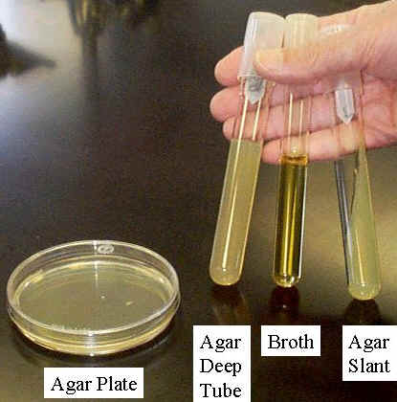
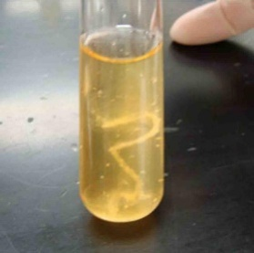
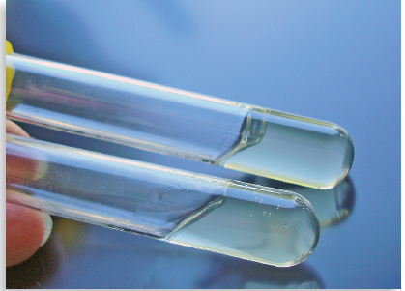
-A- -B- -C-
Figure 1: Type of culture media depending of solidity
3- According to function
A. Differential media: contain reagent that allow differentiation between microorganisms e.g. Eosin methylene blue agar (EMP) for Enterobacteriaceae
B. Selective media: that allow for one microorganisms to grow and prevent growth of anther microorganism e.g. Macanky agar
C. Specialized media: permit the growth of special microorganisms e.g. Minitol salt agar for staphylococcus sp.
D. Enriched media: for growth of fastidious microorganisms e.g. Yeast extract agar for clostridium
E. Enrichment media: enhance the growth of pathogen and inhibit the growth of competitive microorganisms e.g. Tetrathionet broth for salmonella sp.

Slide 6
3. Procedure of preparing media Agar Petri Plates
1. Calculate the amount of media that needs to be made.
♣ Each plate requires 25 – 30 mL of agar, If 100 plates are needed, 2500-3000mL of agar is needed. 2. Follow package instructions for preparation.
♣ Instructions are typically written for 1L (1000mL) of media. If less is desired calculate the amount needed as shown: ♣ For example: If the instructions state 23g for 1L and 600mL is desired, use a ratio to calculate the amount needed (in this example 13.8 g is needed for preparing 600mL): • 23g/1000mL = Xg /600mL
1. 23 * 600= 1000X 2. 13800 = 1000X 3. 13800/1000 =X 4. 13.8 g = X
3. Add powder to beaker first, and then fill with necessary amount of distilled water.

Slide 7
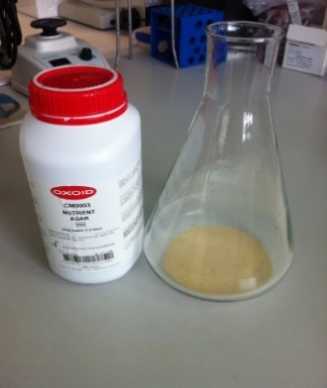
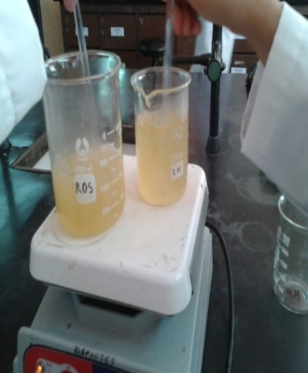
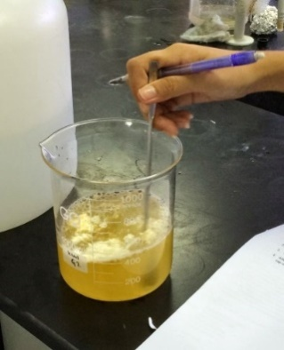
4. Stir with a glass stirring rod to mix. to get the agar powder dissolved
5. Place in microwave and heat at 3-5 minute intervals.
Heat for approximately 10 minutes or until boiling has been achieved.
Figure 3: Dissolving the culturing media
7. Cover the beaker with foil and secure with autoclave tape.

Slide 8
8. Once sterilization is complete, open the autoclave and remove the beaker of media. You must wear the autoclave gloves when removing anything from the autoclave.
9. Allow media to cool slightly, but not for longer than 10 minutes as the agar may solidify.
10. Make a small hole in the foil covering the top in order to pour the agar.
11. Pour approximately 10-15mL of agar into the plates. The bottom of the plate needs to be covered. If necessary, swirl the plate slightly in order to evenly disperse agar.
12. Allow plates to cool on the countertop overnight to reduce condensation.

Slide 9
13. When cooled, store upside-down in plastic bags in the refrigerator to prevent the agar from drying out.
♣ Be sure to seal the plastic bag with masking tape.
♣ Be sure the bag is labelled with its contents, the date it was prepared, and your initials (i.e. Nutrient Agar 8-18-08 KH).

